Slide 1
Agent based learning
Agent-based learning involves simulating autonomous, decision-making entities (agents) that interact within a defined environment, updating their behavior over time through experience, reinforcement learning, or evolutionary strategies. These models, often used to understand complex systems, allow agents to adapt to new situations and learn from past actions, rather than relying solely on pre-programmed rules.
Agent based modelling is a class of computational models that simulate the behaviour of autonomous agents such as people, animals, vehicles or organizations, or even cells. Each agent operates according to a set of rules and interacts with other agents and their environment and then the model then tracks how these local interactions give rise to global patterns.

Slide 2
Core Components of Agent-Based Learning
Agents: Autonomous, independent entities with individual characteristics, goals, and behaviors. Each agent operates according to a set of rules that govern its behavior, decision making processes and interactions with other agents and the environment.
Environment: The space where agents exist, interact, and access resources.
Interaction Rules: Guidelines that define how agents interact with each other and their surroundings.
Learning Mechanism: Methods such as reinforcement learning or genetic algorithms that allow agents to adapt and improve performance over time.
Emergence: System-level patterns that arise from the collective, individual actions of agents.

Slide 3
Agent based learning
Key Characteristics and Applications
Adaptation: Agents update their internal models based on environmental observations to improve future actions.
Heterogeneity: Agents often differ in attributes like age, preferences, or memory, leading to diverse responses.
Applications: Commonly used in complex systems analysis, including economics, social sciences, and organizational behavior.
Simulation & Modeling: These models are used for "bottom-up" simulations, where individual behaviors create system-level phenomena.

Slide 4
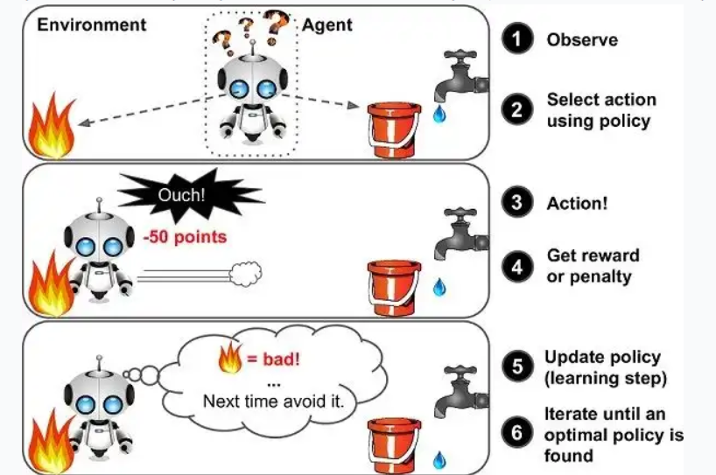
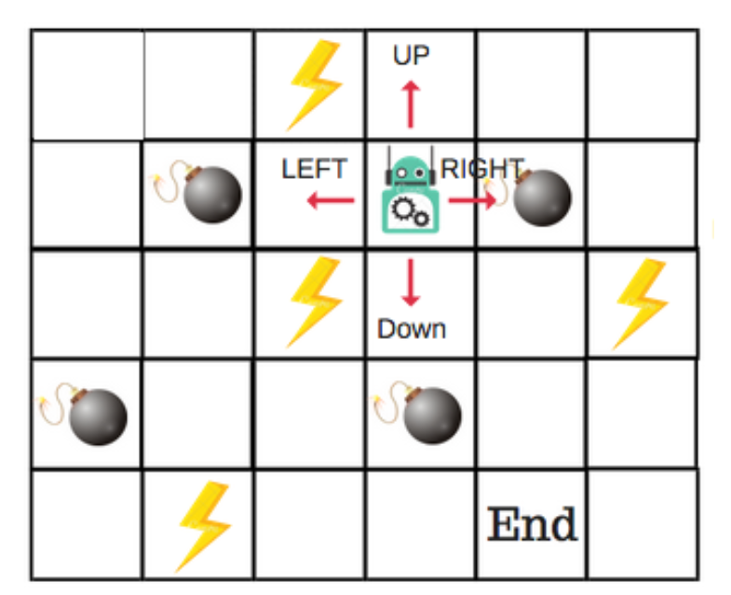
Reinforcement Learning

Slide 5
Reinforcement Learning (RL)
Reinforcement Learning (RL) is the dominant machine learning methodology used to actually execute Agent-Based Learning. It provides the mathematical structure for how the agent learns from its environment.
RL uses a system of numerical rewards and punishments to guide the agent's behavior over time.
The learning system, known as an agent, can observe its environment, choose and perform actions, and receive rewards or penalties (negative rewards) in response.
Self-learning occurs as the agent develops a strategy to maximise its rewards over time.
A policy outlines the action the agent should take when faced with a specific situation.
For example, many robots implement Reinforcement Learning algorithms to learn how to walk.

Slide 6
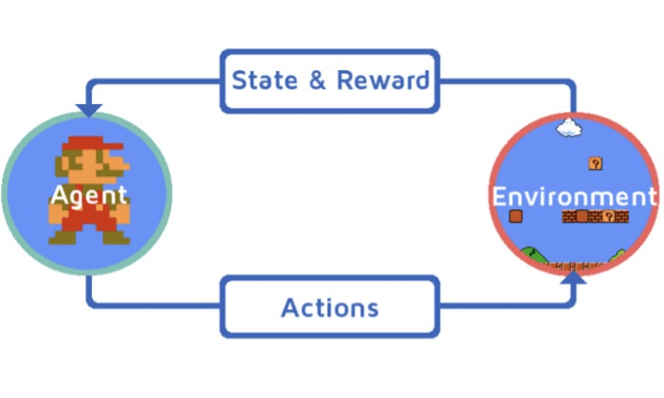
Reinforcement Learning

Slide 7
Key Aspects of Reinforcement Learning
Core Components: The process involves an Agent (the learner), Environment (the world it operates in), State (current situation), Action (decision made), and Reward (feedback).
Learning Process: Unlike supervised learning, RL agents learn by taking actions and experiencing consequences, improving their strategies over time.
Key Paradigms:
Value-based: The agent finds the best strategy by examining the value of specific actions. Example: Q-Learning
Policy-based: The agent determines the best strategy by examining the relationships between actions and outcomes (Directly learn policy). Example: Policy Gradient
Actor-Critic Methods: Combination of value + policy methods.
Model-based: The agent creates an internal model of the environment to simulate and plan actions.

Slide 8
Key Aspects of Reinforcement Learning
Common Algorithms: Frequently used methods include Q-learning, SARSA, and Actor-Critic, often applied in deep learning contexts (Deep Q-Networks).
Applications: RL is used for robotics, autonomous driving, gaming, and optimizing systems like personalized recommendations.
Reinforcement Learning from Human Feedback (RLHF): A specialized form often used to align AI models with human preferences, such as in Large Language Models
Notes:
SARSA (State–Action–Reward–State–Action)

Slide 9
Core Components of Reinforcement Learning
Agent π(s)→a
The learner or decision-maker which observes the environment and take actions an receives rewards accordingly and improves its behavior.
Example: Robot, Self-driving car, Game-playing AI
Environment (st​,at​)→(st+1​,rt​)
The world in which the agent operates and provides feedback to the agent and changes state based on agent’s actions.
Example: Chess board, Road for self-driving car
State (S)
A representation of the current situation of the environment. It contains all necessary information for decision-making.
Example: In chess → board configuration, In robot navigation → current position

Slide 10
Core Components of Reinforcement Learning
Action (A)
The set of possible moves the agent can take.
Example: Move left/right, Accelerate/brake
Reward (R) R:S×A→R
Represents the goal of the RL problem.
Reward guides learning.
Guides the agent by providing feedback (positive/negative rewards). Positive reward → good action, Negative reward → bad action
Example: +10 for winning a game, -1 for collision, For self-driving cars rewards can be fewer collisions, shorter travel time, lane discipline.

Slide 11
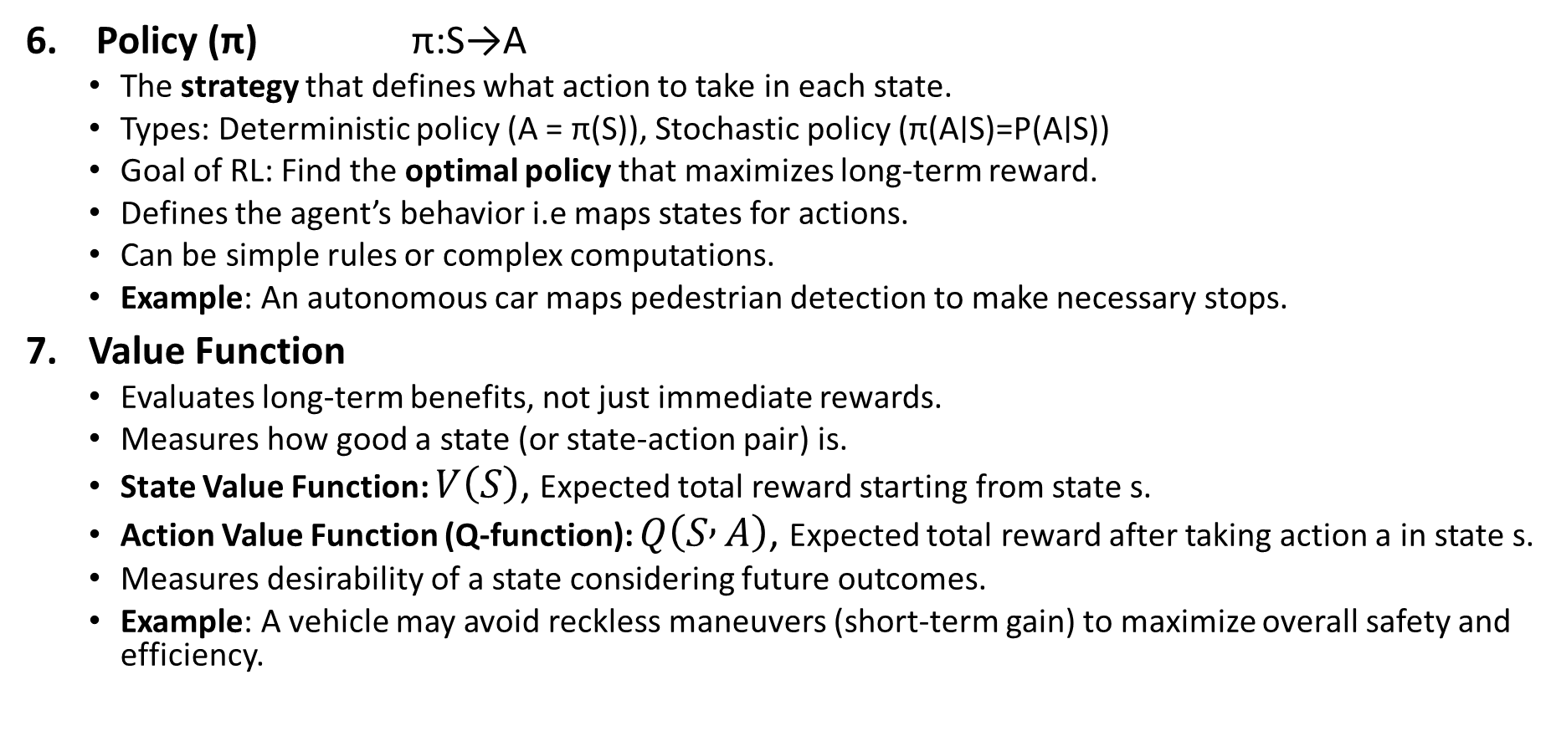
Core Components of Reinforcement Learning
Policy (π) π:S→A
The strategy that defines what action to take in each state.
Types: Deterministic policy (A = π(S)), Stochastic policy (π(A∣S)=P(A∣S))
Goal of RL: Find the optimal policy that maximizes long-term reward.
Defines the agent’s behavior i.e maps states for actions.
Can be simple rules or complex computations.
Example: An autonomous car maps pedestrian detection to make necessary stops.
Value Function
Evaluates long-term benefits, not just immediate rewards.
Measures how good a state (or state-action pair) is.
State Value Function: $V\left(S\right)$, Expected total reward starting from state s.
Action Value Function (Q-function): $Q\left(S , A\right)$, Expected total reward after taking action a in state s.
Measures desirability of a state considering future outcomes.
Example: A vehicle may avoid reckless maneuvers (short-term gain) to maximize overall safety and efficiency.

Slide 12
Core Components of Reinforcement Learning
Model (Optional)
A mathematical description of how the environment works.
Model-based RL → knows transition probabilities
Model-free RL → learns from experience
Simulates the environment to predict outcomes of actions.
Enables planning and foresight.
Example: Predicting other vehicles’ movements to plan safer routes.
Exploration vs Exploitation
One of the most important concepts in RL.
Exploitation : Choose the best known action.
Exploration: Try new actions to discover better rewards.
Common strategy: ε-greedy method
With probability ε → explore, With probability 1-ε → exploit

Slide 13
Working of Reinforcement Learning
The agent interacts iteratively with its environment in a feedback loop:
The agent observes the current state of the environment.
It chooses and performs an action based on its policy.
The environment responds by transitioning to a new state and providing a reward (or penalty).
The agent updates its knowledge (policy, value function) based on the reward received and the new state.
This cycle repeats with the agent balancing exploration (trying new actions) and exploitation (using known good actions) to maximize the cumulative reward over time. This process is mathematically framed as a Markov Decision Process (MDP) where future states depend only on the current state and action, not on the prior sequence of events.

Slide 14
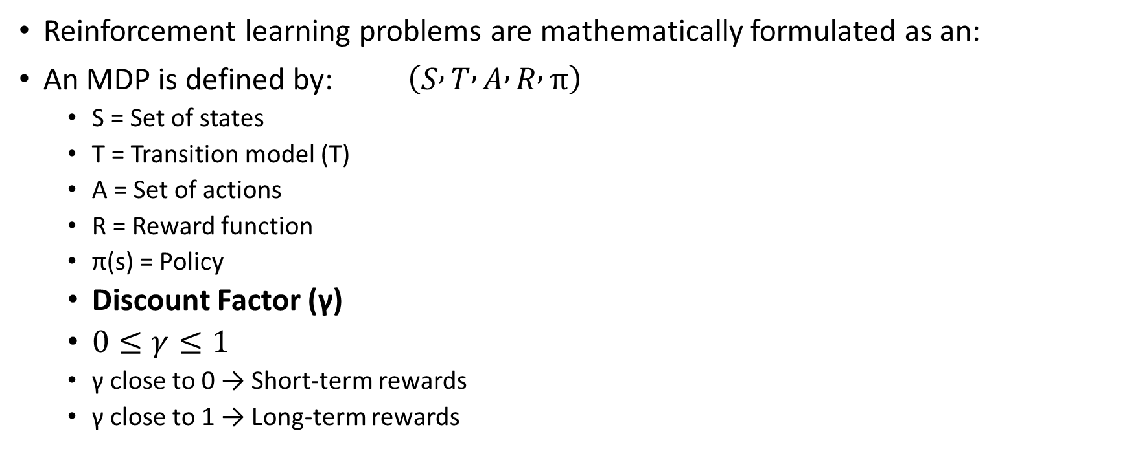
Markov Decision Process (MDP)
Reinforcement learning problems are mathematically formulated as an:
An MDP is defined by: $\left(S , T , A , R , π\right)$
S = Set of states
T = Transition model (T)
A = Set of actions
R = Reward function
π(s) = Policy
Discount Factor (γ)
$0≤γ≤1$
γ close to 0 → Short-term rewards
γ close to 1 → Long-term rewards

Slide 15
Markov Decision Process (MDP)
1. States (S): A state is a situation or condition the agent can be in. For example, A position on a grid like being at cell (1,1).
2. Actions (A): An action is something the agent can do. For example, Move UP, DOWN, LEFT or RIGHT. Each state can have one or more possible actions.
3. Transition Model (T): The model tells us what happens when an action is taken in a state. It’s like asking: “If I move RIGHT from here, where will I land?” Sometimes the outcome isn’t always the same that’s uncertainty. For example:
80% chance of moving in the intended direction
10% chance of slipping to the left
10% chance of slipping to the right
This randomness is called a stochastic transition.

Slide 16
Markov Decision Process (MDP)
4. Reward (R): A reward is a number given to the agent after it takes an action. If the reward is positive, it means the result of the action was good. If the reward is negative it means the outcome was bad or there was a penalty help the agent learn what’s good or bad. Examples:
+1 for reaching the goal
-1 for stepping into fire
-0.1 for each step to encourage fewer moves
5. Policy (π): A policy is the agent’s plan. It tells the agent: “If you are in this state, take this action.” The goal is to find the best policy that helps the agent earn the highest total reward over time.

Slide 17
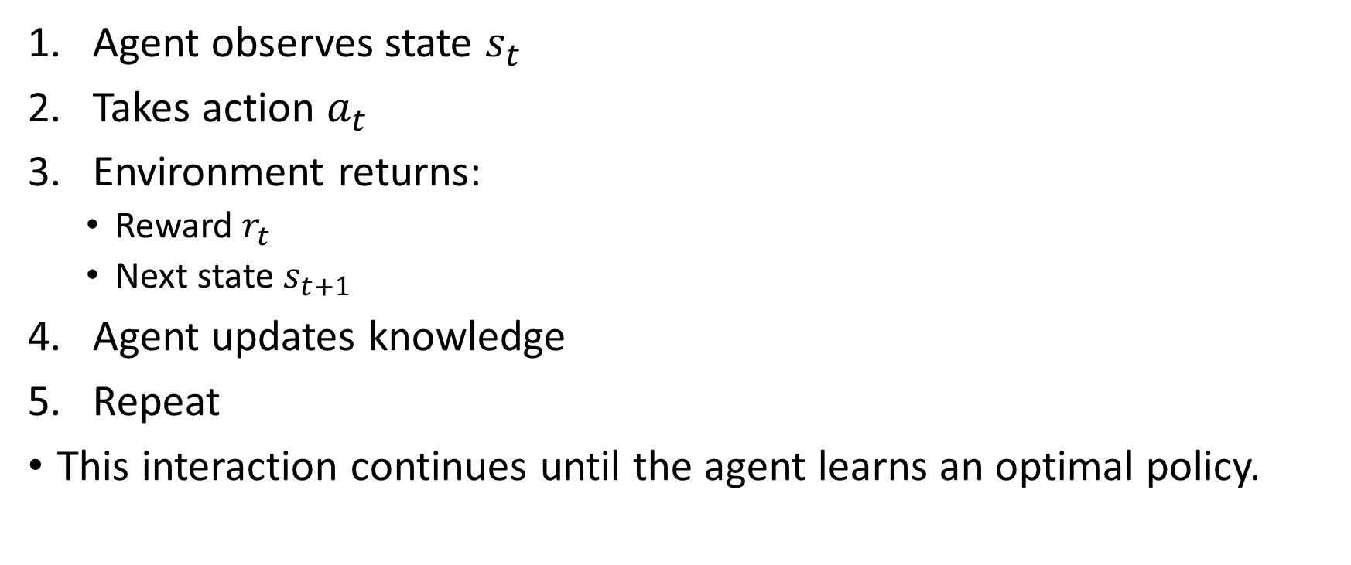
How RL Learning Happens (Basic Flow)
Agent observes state $s_{t}$
Takes action $a_{t}$
Environment returns:
Reward $r_{t}$
Next state $s_{t+1}$
Agent updates knowledge
Repeat
This interaction continues until the agent learns an optimal policy.

Slide 18
Reinforcement Learning
Advantages
Learns without labeled data
Suitable for dynamic environments
Handles sequential decision problems
Can optimize long-term performance
Disadvantages / Challenges
Requires large number of interactions
Slow convergence
Reward design is difficult
Exploration may be risky in real systems
Computationally expensive

Slide 19
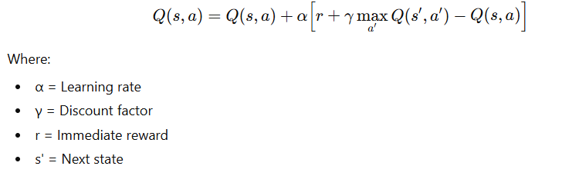
Q-learning
Agent-Based Learning is the broad paradigm, Reinforcement Learning is the specific mathematical framework used to achieve it, and Q-Learning is one specific algorithm within that framework.
Q-learning update rule:

Slide 20
Example: Simple 2-State System
States: S1, S2 (Terminal)
Actions from S1: A1, A2
Rewards:
If A1 → go to S2, reward = 5
If A2 → stay in S1, reward = 1
Parameters:
α = 0.5
γ = 0.9
Initial Q = 0

Slide 21
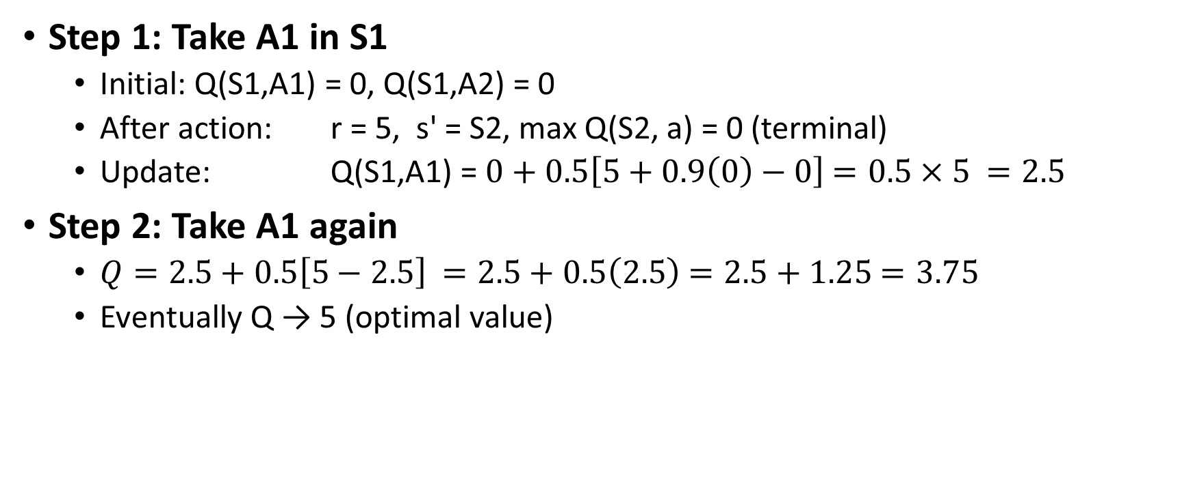
Example: Simple 2-State System
Step 1: Take A1 in S1
Initial: Q(S1,A1) = 0, Q(S1,A2) = 0
After action: r = 5, s' = S2, max Q(S2, a) = 0 (terminal)
Update: Q(S1,A1) =$0+0.5\left[5+0.9\left(0\right)−0\right]$ $=0.5×5$ $=2.5$
Step 2: Take A1 again
$Q=2.5+0.5\left[5−2.5\right]$ $=2.5+0.5\left(2.5\right)$ $=2.5+1.25$ $=3.75$
Eventually Q → 5 (optimal value)

Slide 22
Example: 2×2 Grid
State
S1 | S2
S3 | Goal
Reward:
Goal = +10
Other = -1 per step
Actions: Up, Down, Left, Right
Initial Q-table:
Assume:
α = 0.5, γ = 0.9
State | Up | Down | Left | Right
S1 | 0 | 0 | 0 | 0
S2 | 0 | 0 | 0 | 0
S3 | 0 | 0 | 0 | 0

Slide 23
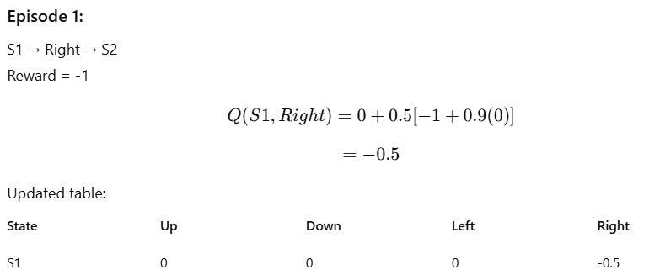
Example: 2×2 Grid

Slide 24
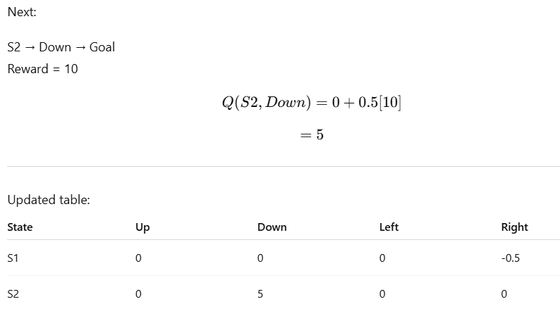
Example: 2×2 Grid

Slide 25

Example: 2×2 Grid
Next episode, S3 → Right:
$Q=−0.5+0.5\left[−1+0.9\left(5\right)+0.5\right]$ $=−0.5+0.5\left[3.5+0.5\right]$ $=−0.5+2$ $=1.5$
State | Up | Down | Left | Right
S1 | 0 | 0 | 0 | -0.5
S2 | 0 | 5 | 0 | 0
S3 | 0 | 0 | 0 | 1.5

